Slide 1

Presentation on
Student Faculty Communication Protocol
-presented by
Team ZeroSplash
Application Design and Development (Project)
CSEP-3209
sfcm.contact.com
Notes:
Assalamu alaikum , Thankyou to our honorable, Dr. Sajeeb Saha sir for giving us the opportunity,. So now we are going to discuss about our Application Project Student Faculty Communication Protocol.

Slide 2


Table of contents
Team Contents
ER Diagram
Introduction
User activity Diagram (Teacher)
Problem statement and Solution
User activity Diagram (student)
Tools and technologies
Use case Diagram
Business Model
Data flow Diagram
Software Development Model
Implementation
Users of this App
Team Contents
Notes:
So, Here we Divided our project presentation into many contents on various criteria. Lets
Talk about this contents:

Slide 3

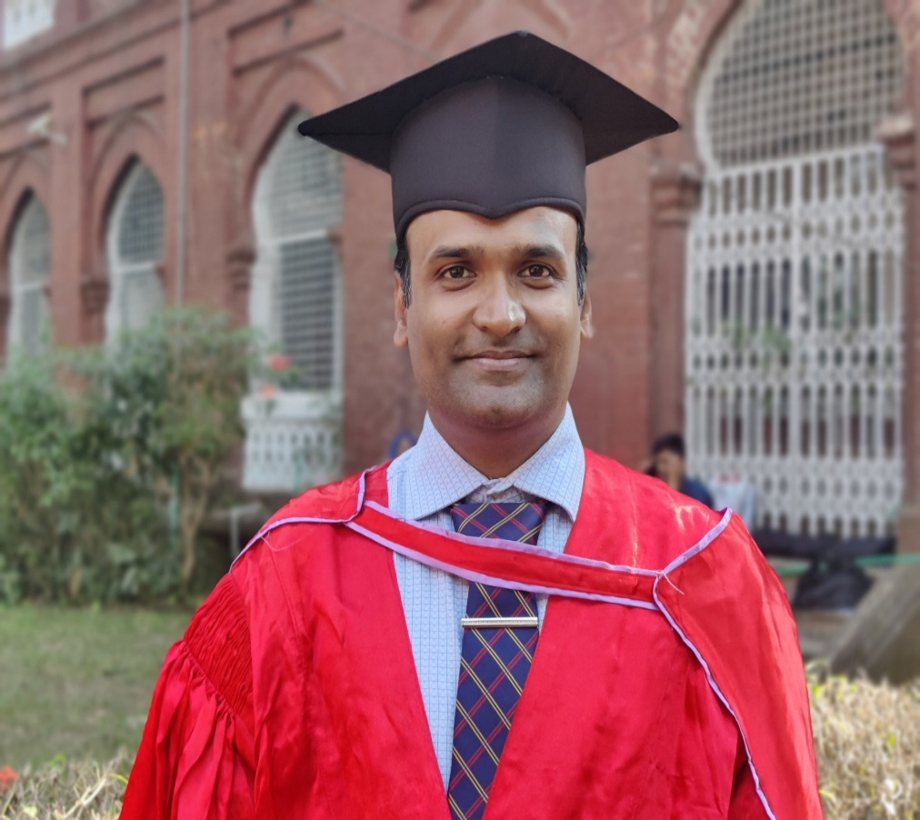
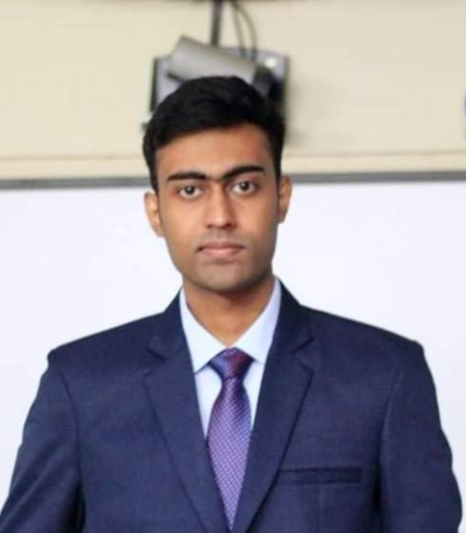
Student Faculty Communication Protocol
Supervised by,
Presented by,
Md. Sakibul Islam
Dr. Sajeeb Saha
AssociateProfessor
Id: B190305035
Dept. of Computer Science & Engineering
Jagannath University, Dhaka
&
Asifuzzaman
Id: B190305023
Dept. of Computer Science & Engineering
Jagannath University, Dhaka
Notes:
This Sfcp project is presented by our team ZeroSplash and it is presented to and also supervised by Dr. sajeeb saha sir

Slide 4

INTRODUCTION
Streamlines file sharing between teachers and students
Enhances collaboration and engagement
Promotes interactive learning
Improves communication beyond the classroom
"Connecting Educators and Students One File at a Time"
Notes:
Sfcp project streamlines file sharing between teachers and students, it enhances collaboration and engagement, promotes interactive learning and also improves communication beyond the classroom. Overall We can just say “Connecting Educators and students one file at a time”

Slide 5
Student Faculty Communication Protocol
(problem statement)
Inefficiencies in Sharing Educational Materials:
Traditional methods of sharing course materials and resources are inefficient.
Students often struggle to access information promptly.
Challenges for Students:
Difficulty in obtaining essential course materials.
Limited access to resources, causing delays in information retrieval.
Challenges for Teachers:
Teachers face hurdles in distributing materials to diverse learners.
Ineffective management of educational content flow.
4. Consequences:
Missed deadlines and confusion are common outcomes..
(Solutions)
Streamlined File Sharing.
Enhanced Collaboration.
Personalized Learning.
Improved Communication.
Efficient Administration.
Notes:
In daily life we have faced some that’s why we decided to build this Application to solve that problem. The major problem statements are: Inefficiencies in Sharing Educational Materials, Obtaining Essential course materials which is challenges for students, Facing Hurdle in distributing materials to diverse learners is so difficult for teachers. So here is some of the solutions we findout : Streamlined file sharing , enhanced Collaboration, personalized learning ,improved communication and Efficient Administration

Slide 6
USED TOOLS
SOFTWARE REQUIREMENTS
HARDWARE REQUIREMENTS
Front End: Android Studio XML
CPU Architecture: ARM/ARM64
Back End: Java, Firebase Realtime
Database, Firebase Authentication.
RAM: 1GB(at least)
Operating System: Android OS
Processor: Snapdragon, Exynos, etc.
6
Notes:
Tools We used In our Application are on the basis of software and hardware: For software front end are android studio, backend, java , firebase realtime database, authentication, Android Os

Slide 7
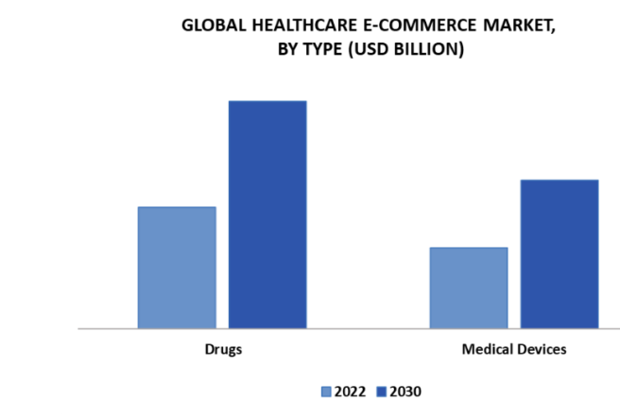
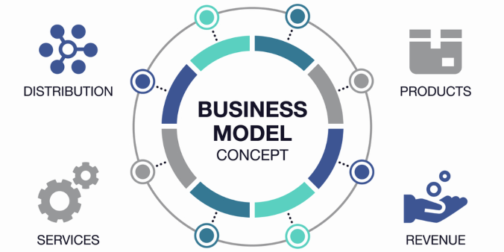
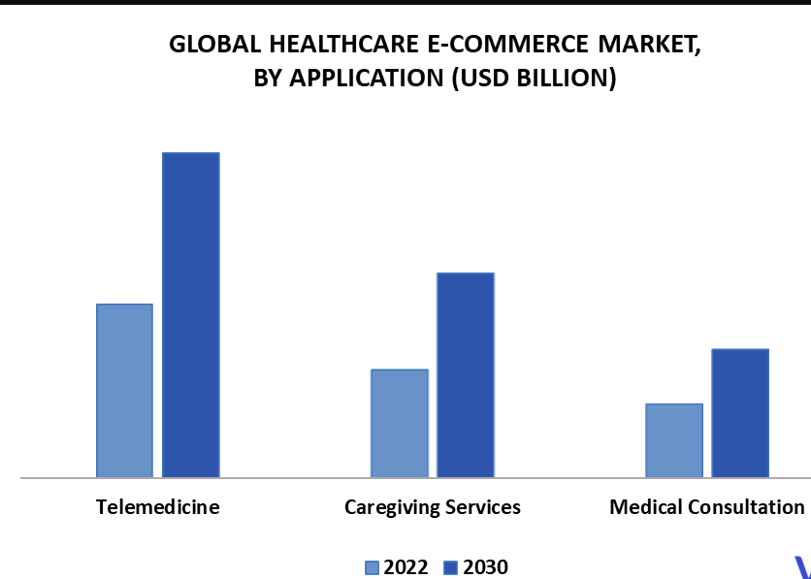
BUSINESS MODEL
1
Premium Version (Paid).
2
Institutional Licensing.
3
Advertisement and Partnerships
For different course or learning materials
Custom Development and
Integration.
4

Slide 8
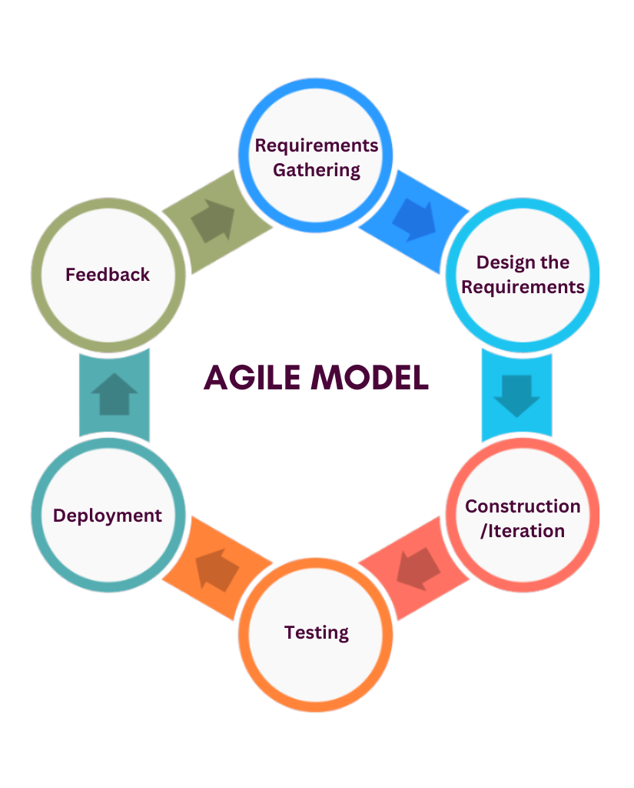
Software Development
Model
User Authentication
Teacher, Student Dashboard
Search and Filter
Course Management
Responsive Design
Notice, File Management
Collaborative Environment
Enrollment
Iterative Improvements

Slide 9
USERS OF THIS APP
There are mainly three types of user in this project. They are:
Admin
Manipulates user data and control database
Ensures data security
Teacher
Approve Course Requests
Upload Notice, Images, Documents on particular course
Create courses for particular batch
Student
Upload homework and images
Enroll courses

Slide 10
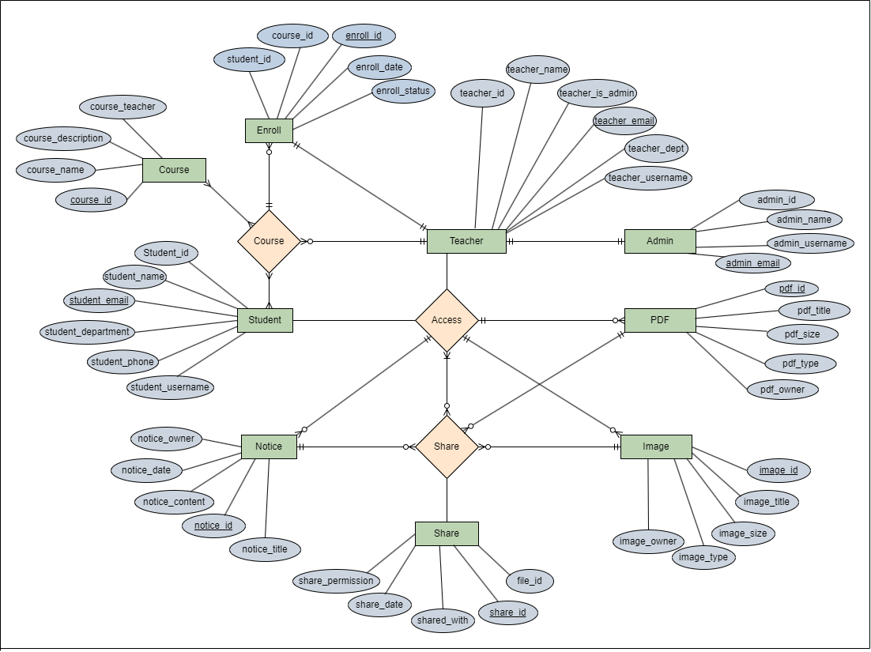
E-R DIAGRAM

Slide 11
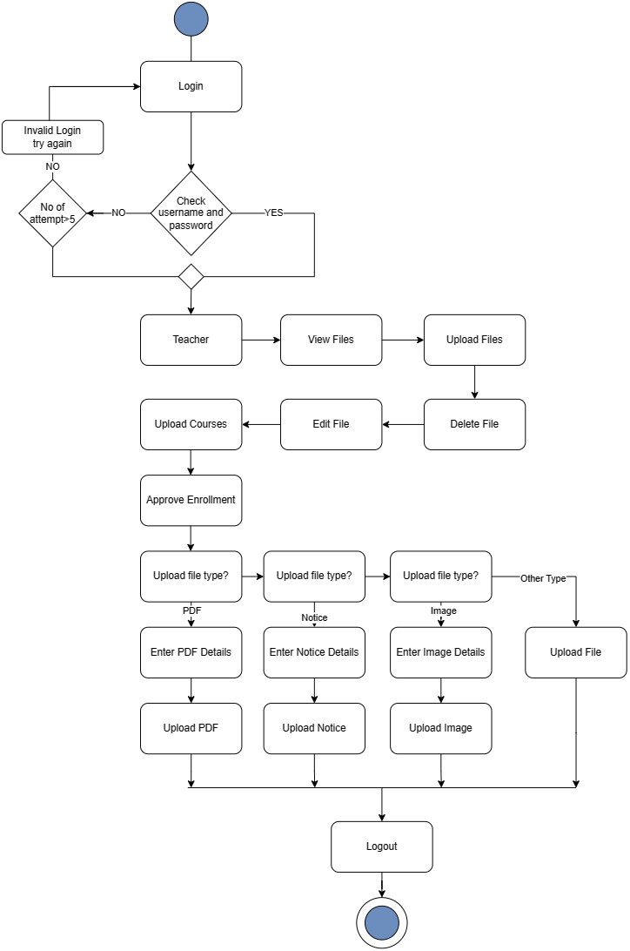
/Register
USER ACTIVITY DIAGRAM
(Teacher)
Credential
Notes:
When teacher upload pdf, notice images they also have to provide details about that file. After done everything they can logout if they want.

Slide 12
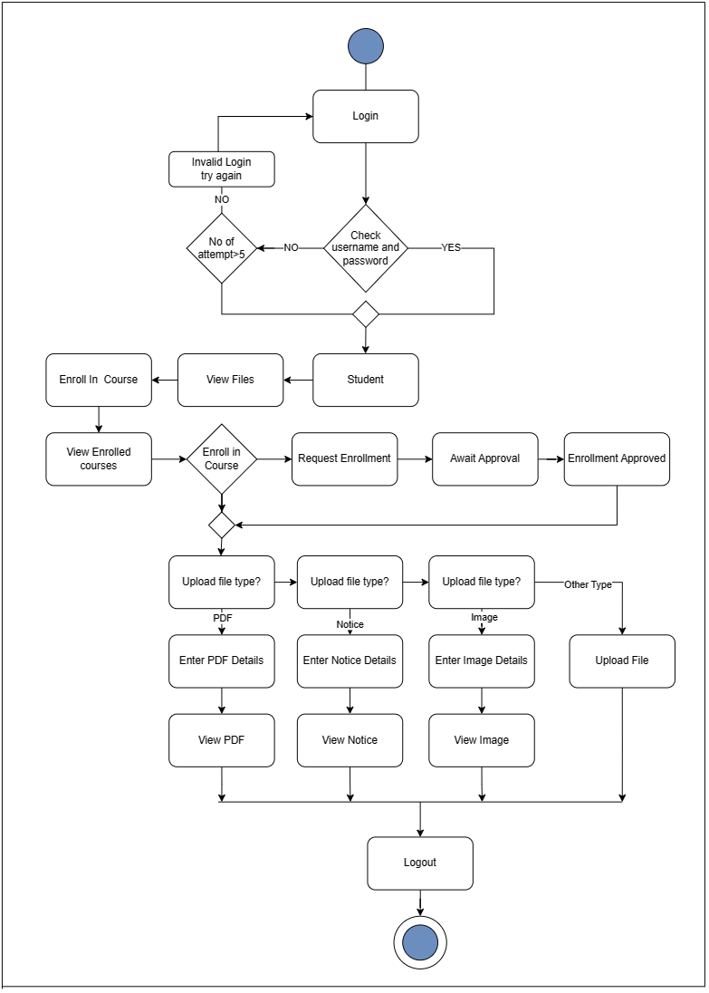
/Register
USER ACTIVITY DIAGRAM
(Student)
Credential
Notes:
After successfully login student can view files, request enrollment for courses also can upload images, document with details and view pdf notices and images. After done everything they can logout if they want.

Slide 13
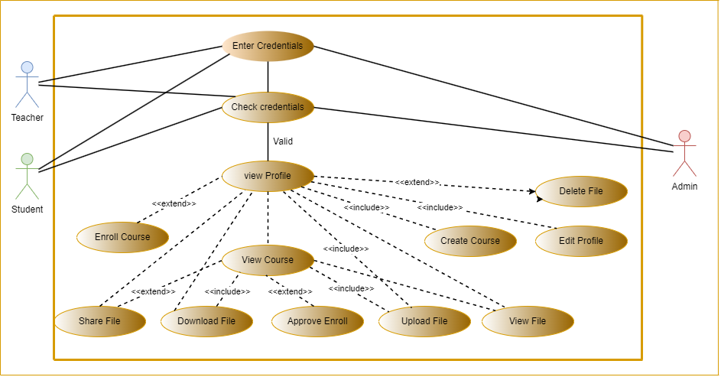
USE CASE DIAGRAM
Notes:
We can see that teacher, admin, student have to enter there credentials and successfully pass their validity for accessing their profile. Now Which functions are always usable this will be include and which functions are rarely used by particular user that will be extend.

Slide 14
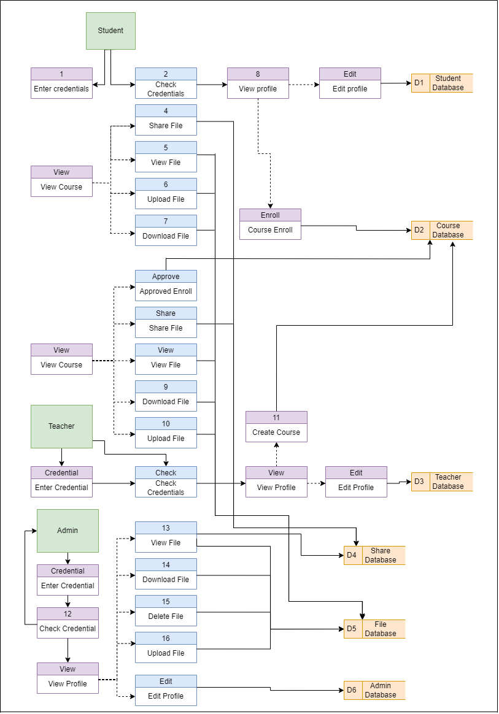
DATA FLOW
DIAGRAM
Notes:
When student teacher admin uses there information into login session all off those data will be saved in to database and uses when it needed.

Slide 15
IMPLEMENTATION

Slide 16






